Slide 1


Satellite Gravimetry
João Encarnação, Ph.D
(Center for Space Research, UT Austin)

Slide 2
Summary
Gravity
Geoid
Mass transport processes
Measurement principles
Satellite missions
Instrumentation
Data
Methodology
Processing strategies

Slide 3
Gravity
9.8 m/s², right?

Slide 4
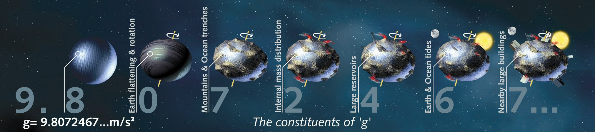
Gravity
http://www.esa.int/var/esa/storage/images/esa_multimedia/images/2008/04/constituents_of_g/9562179-4-eng-GB/Constituents_of_g.jpg

Slide 5
Gravity: terminology
gravitational field/force: as a result of mass (a phenomenon)
gravity field/force: caused by a planet’s mass (e.g. Earth) which, at its surface, includes the centrifugal acceleration resulting from planetary rotation (a realization of a phenomenon)

Slide 6
Gravity
How to represent these spatial changes?

Slide 7
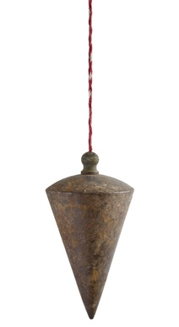
Gravity: up and down
shutterstock.com

Slide 8
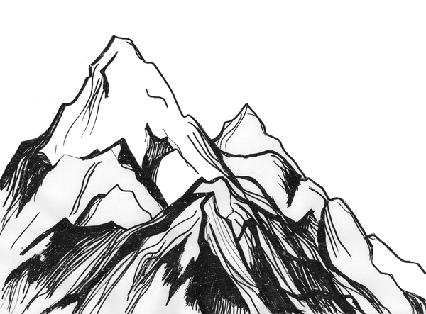
Gravity: up and down
http://awesome-mountains.blogspot.com/2013/01/mountains-sketch.html
shutterstock.com

Slide 9
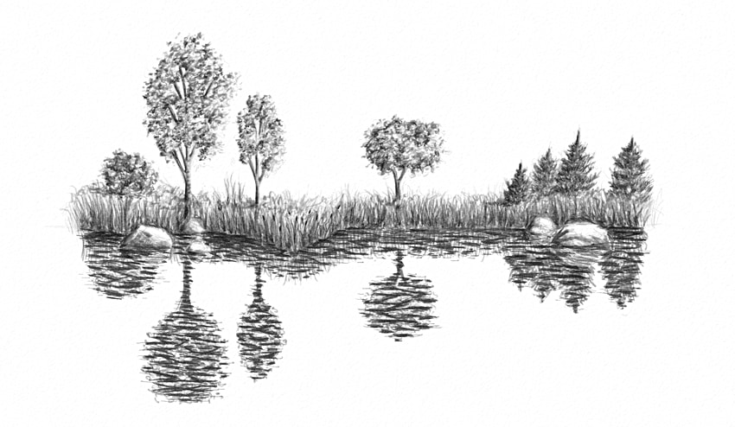
Gravity: up and down
http://awesome-mountains.blogspot.com/2013/01/mountains-sketch.html
shutterstock.com
https://design.tutsplus.com/tutorials/how-to-draw-bodies-of-water--cms-27055

Slide 10
Gravity: Physics and Geometry
Geoid
Ellipsoid
http://awesome-mountains.blogspot.com/2013/01/mountains-sketch.html
shutterstock.com
https://design.tutsplus.com/tutorials/how-to-draw-bodies-of-water--cms-27055

Slide 11
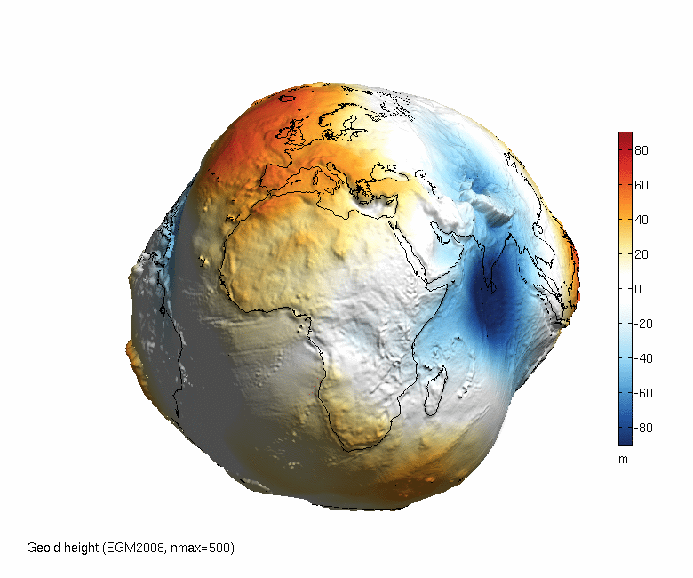
Gravity: geoid
http://www.asu.cas.cz/~bezdek/vyzkum/rotating_3d_globe/figures/rotating_3d_globe_Geoid_height_EGM2008_nmax500_px0650_angle360_fps1_BlueWhiteOrangeRed.gif

Slide 12
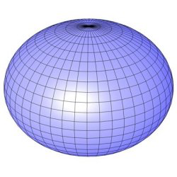

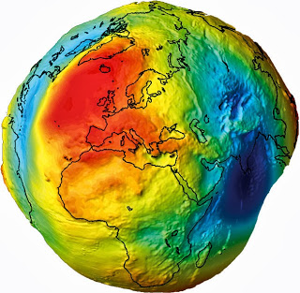
Gravity
That’s it?
-
=
+ ?
http://www.iconarchive.com/tag/earth
http://www.daviddarling.info/encyclopedia/E/ellipsoid.html
http://deepearthscience.blogspot.com/2013/10/measuring-geoid-what-is-geoid.html

Slide 13
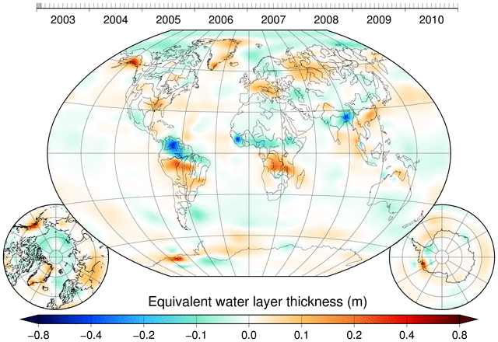
Gravity: Time-varying
http://www.citg.tudelft.nl/en/about-faculty/departments/geoscience-and-remote-sensing/research-themes/geodesy/gravity/models-data/champgracegoce-gravity-models-data/dmt-1b/

Slide 14
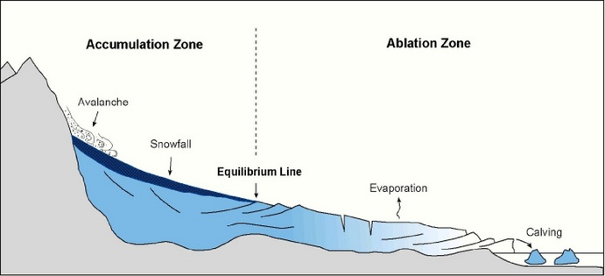
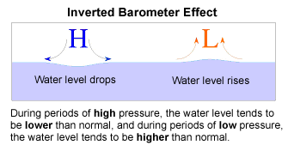
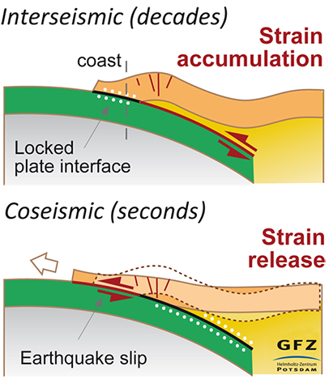
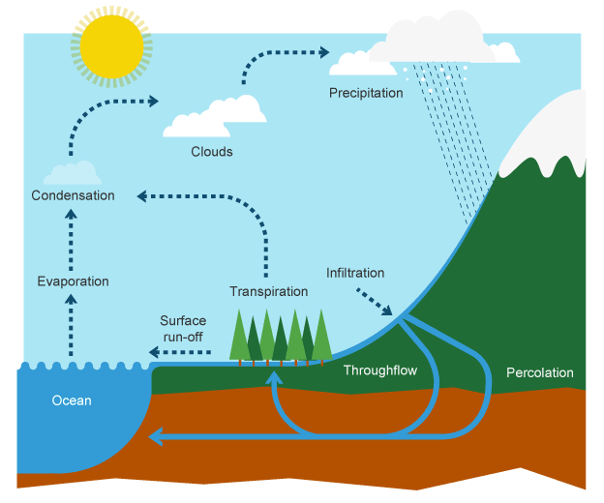
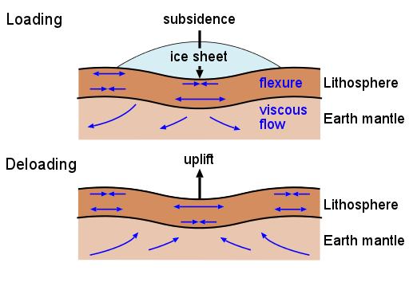
Mass transport processes
Atmosphere and Ocean
Solid Earth
Glaciology
http://www.oc.nps.edu/nom/day1/partc.html
https://uwcm-geog.wikispaces.com/EXTREME+ENVIRONMENTS
Hydrology
Glacial Isostatic adjustment
http://www.gfz-potsdam.de/en/media-communication/news/details/article/megabeben-stossen-sich-gegenseitig-an-mechanismen-fuer-erdbebenzyklen-an-chiles-plattengrenze-au/
http://www.bbc.co.uk/education/guides/z4bk7ty/revision
http://www.gfz-potsdam.de/en/section/earth-system-modelling/topics/ice-sheet-and-solid-earth-dynamics/glacial-isostatic-adjustment-gia/

Slide 15
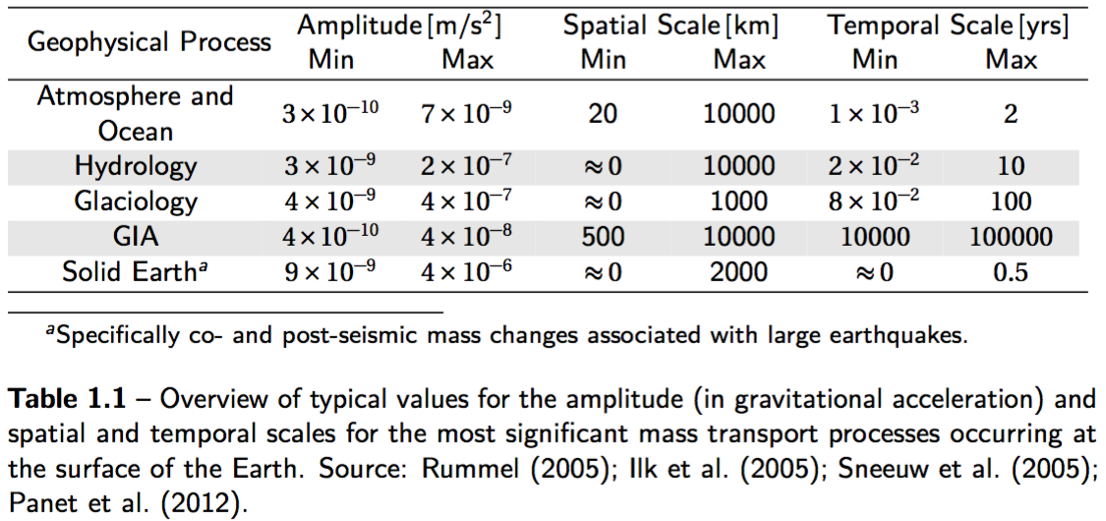
Gravity: Time-varying
https://repository.tudelft.nl/islandora/object/uuid:d0c61fd2-804b-4827-ae8a-e0e93d282a56

Slide 16
Measuring gravity
How can that be measured?

Slide 17
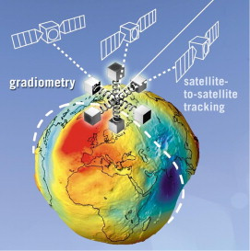
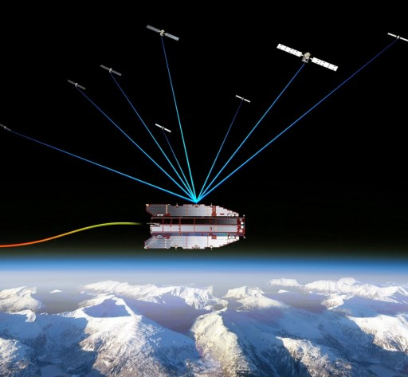
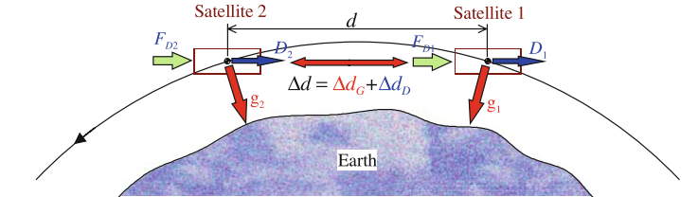
Measurement Principles
High-Low Satellite to Satellite Tracking
Low-Low Satellite to Satellite Tracking
Gradiometry
http://www.esa.int/spaceinimages/Images/2008/08/GOCE_tracked_by_GPS_satellites
http://link.springer.com/10.1007/978-3-642-03501-2_11
http://www.sciencedirect.com/science/article/pii/S0094576510002122

Slide 18
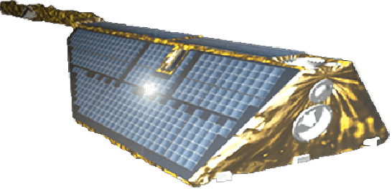
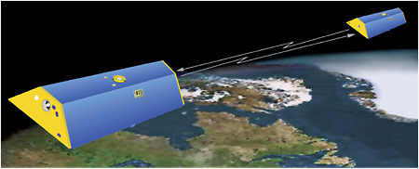
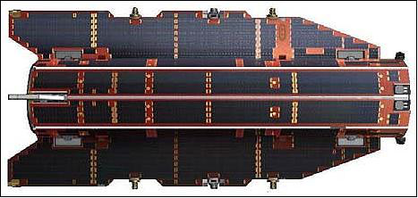
Satellite Missions
CHAMP 2000 – 2010
CHAllenging Minisatellite Payload
GRACE 2002 – present
Gravity Recovery and Climate Experiment
GOCE 2009 – 2013
Gravity field and steady-state Ocean Circulation Explorer
http://www.gfz-potsdam.de/en/section/space-geodetic-techniques/projects/champ-ro/
https://www.nap.edu/read/12954/chapter/5
https://directory.eoportal.org/web/eoportal/satellite-missions/g/goce

Slide 19
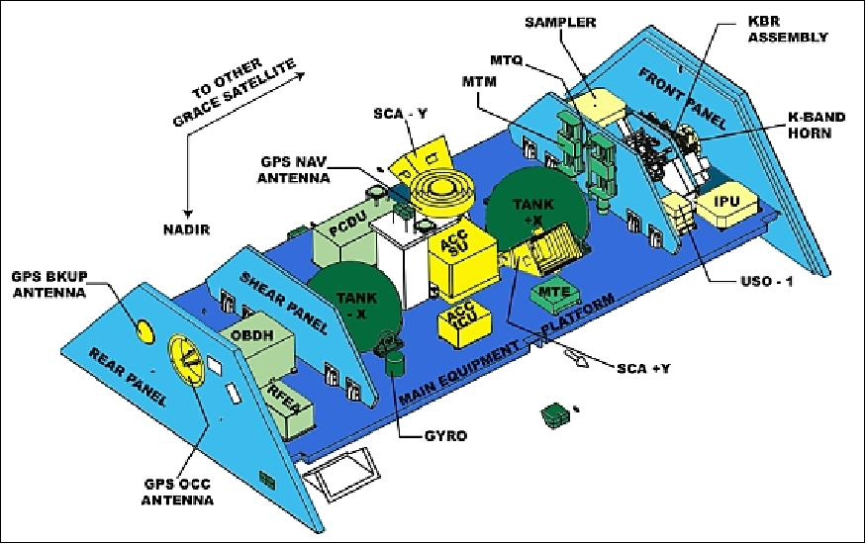
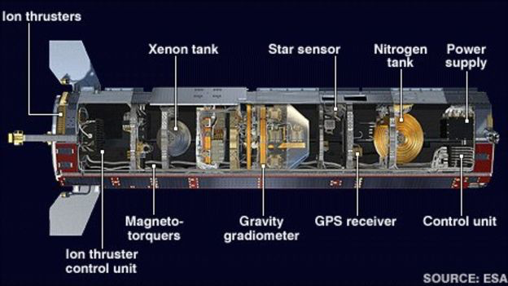
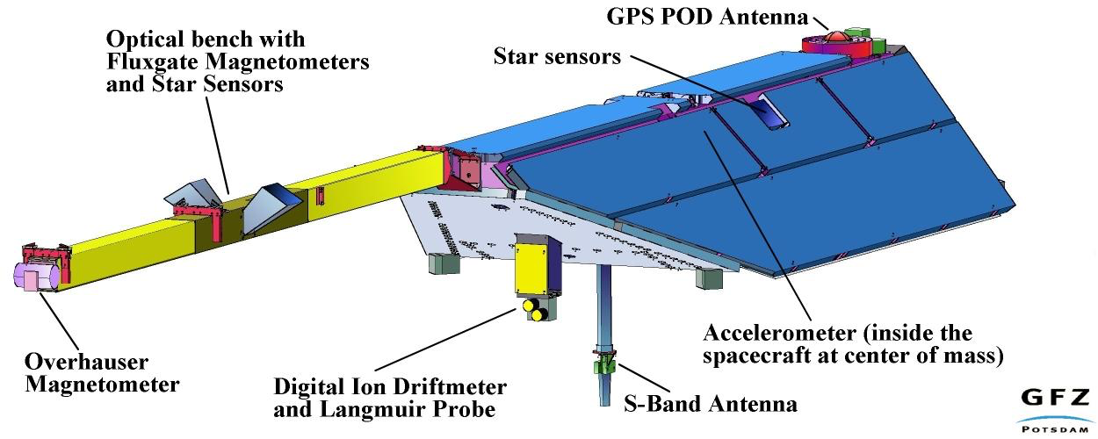
Instrumentation
Attitude
Non-gravitational accelerations
Absolute position
Relative position
CHAMP
GRACE
GOCE
http://op.gfz-potsdam.de/champ/systems/main_SYSTEMS.html
https://directory.eoportal.org/web/eoportal/satellite-missions/g/grace-fo
http://www.bbc.com/news/science-environment-24043526

Slide 20
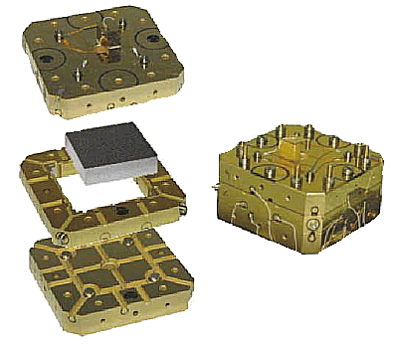
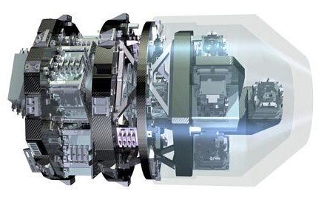
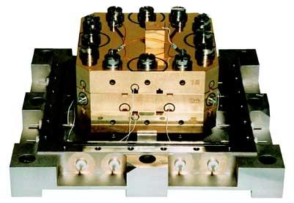
Accelerometer
CHAMP
GRACE
GOCE
https://directory.eoportal.org/web/eoportal/satellite-missions/c-missions/champ
http://op.gfz-potsdam.de/champ/systems/main_SYSTEMS.html
https://beyondthecradle.wordpress.com/2009/04/08/defying-gravity-to-define-gravity-goces-heart-starts-beating/

Slide 21
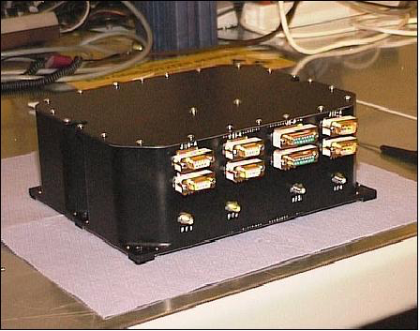
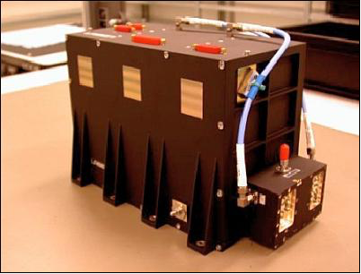
GPS Receiver
CHAMP
GRACE
GOCE
https://directory.eoportal.org/web/eoportal/satellite-missions/c-missions/champ
https://directory.eoportal.org/web/eoportal/satellite-missions/g/grace
https://directory.eoportal.org/web/eoportal/satellite-missions/g/goce

Slide 22
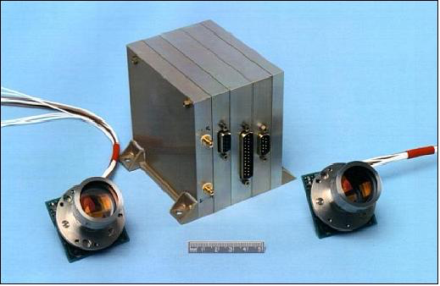
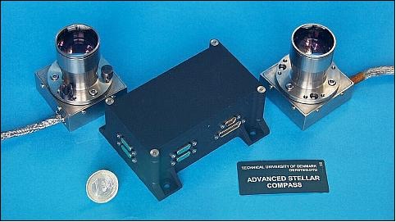
Star Tracker
CHAMP
GRACE
GOCE
https://directory.eoportal.org/web/eoportal/satellite-missions/c-missions/champ
https://directory.eoportal.org/web/eoportal/satellite-missions/g/grace
https://directory.eoportal.org/web/eoportal/satellite-missions/g/goce

Slide 23
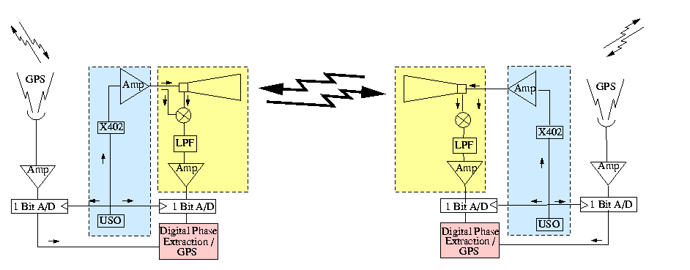
Inter-satellite ranging
CHAMP
GRACE
GOCE
N/A
N/A
K-Band Ranging (KBR) System
(24 and 32 GHz)

Slide 24
Data
What is the data like?

Slide 25
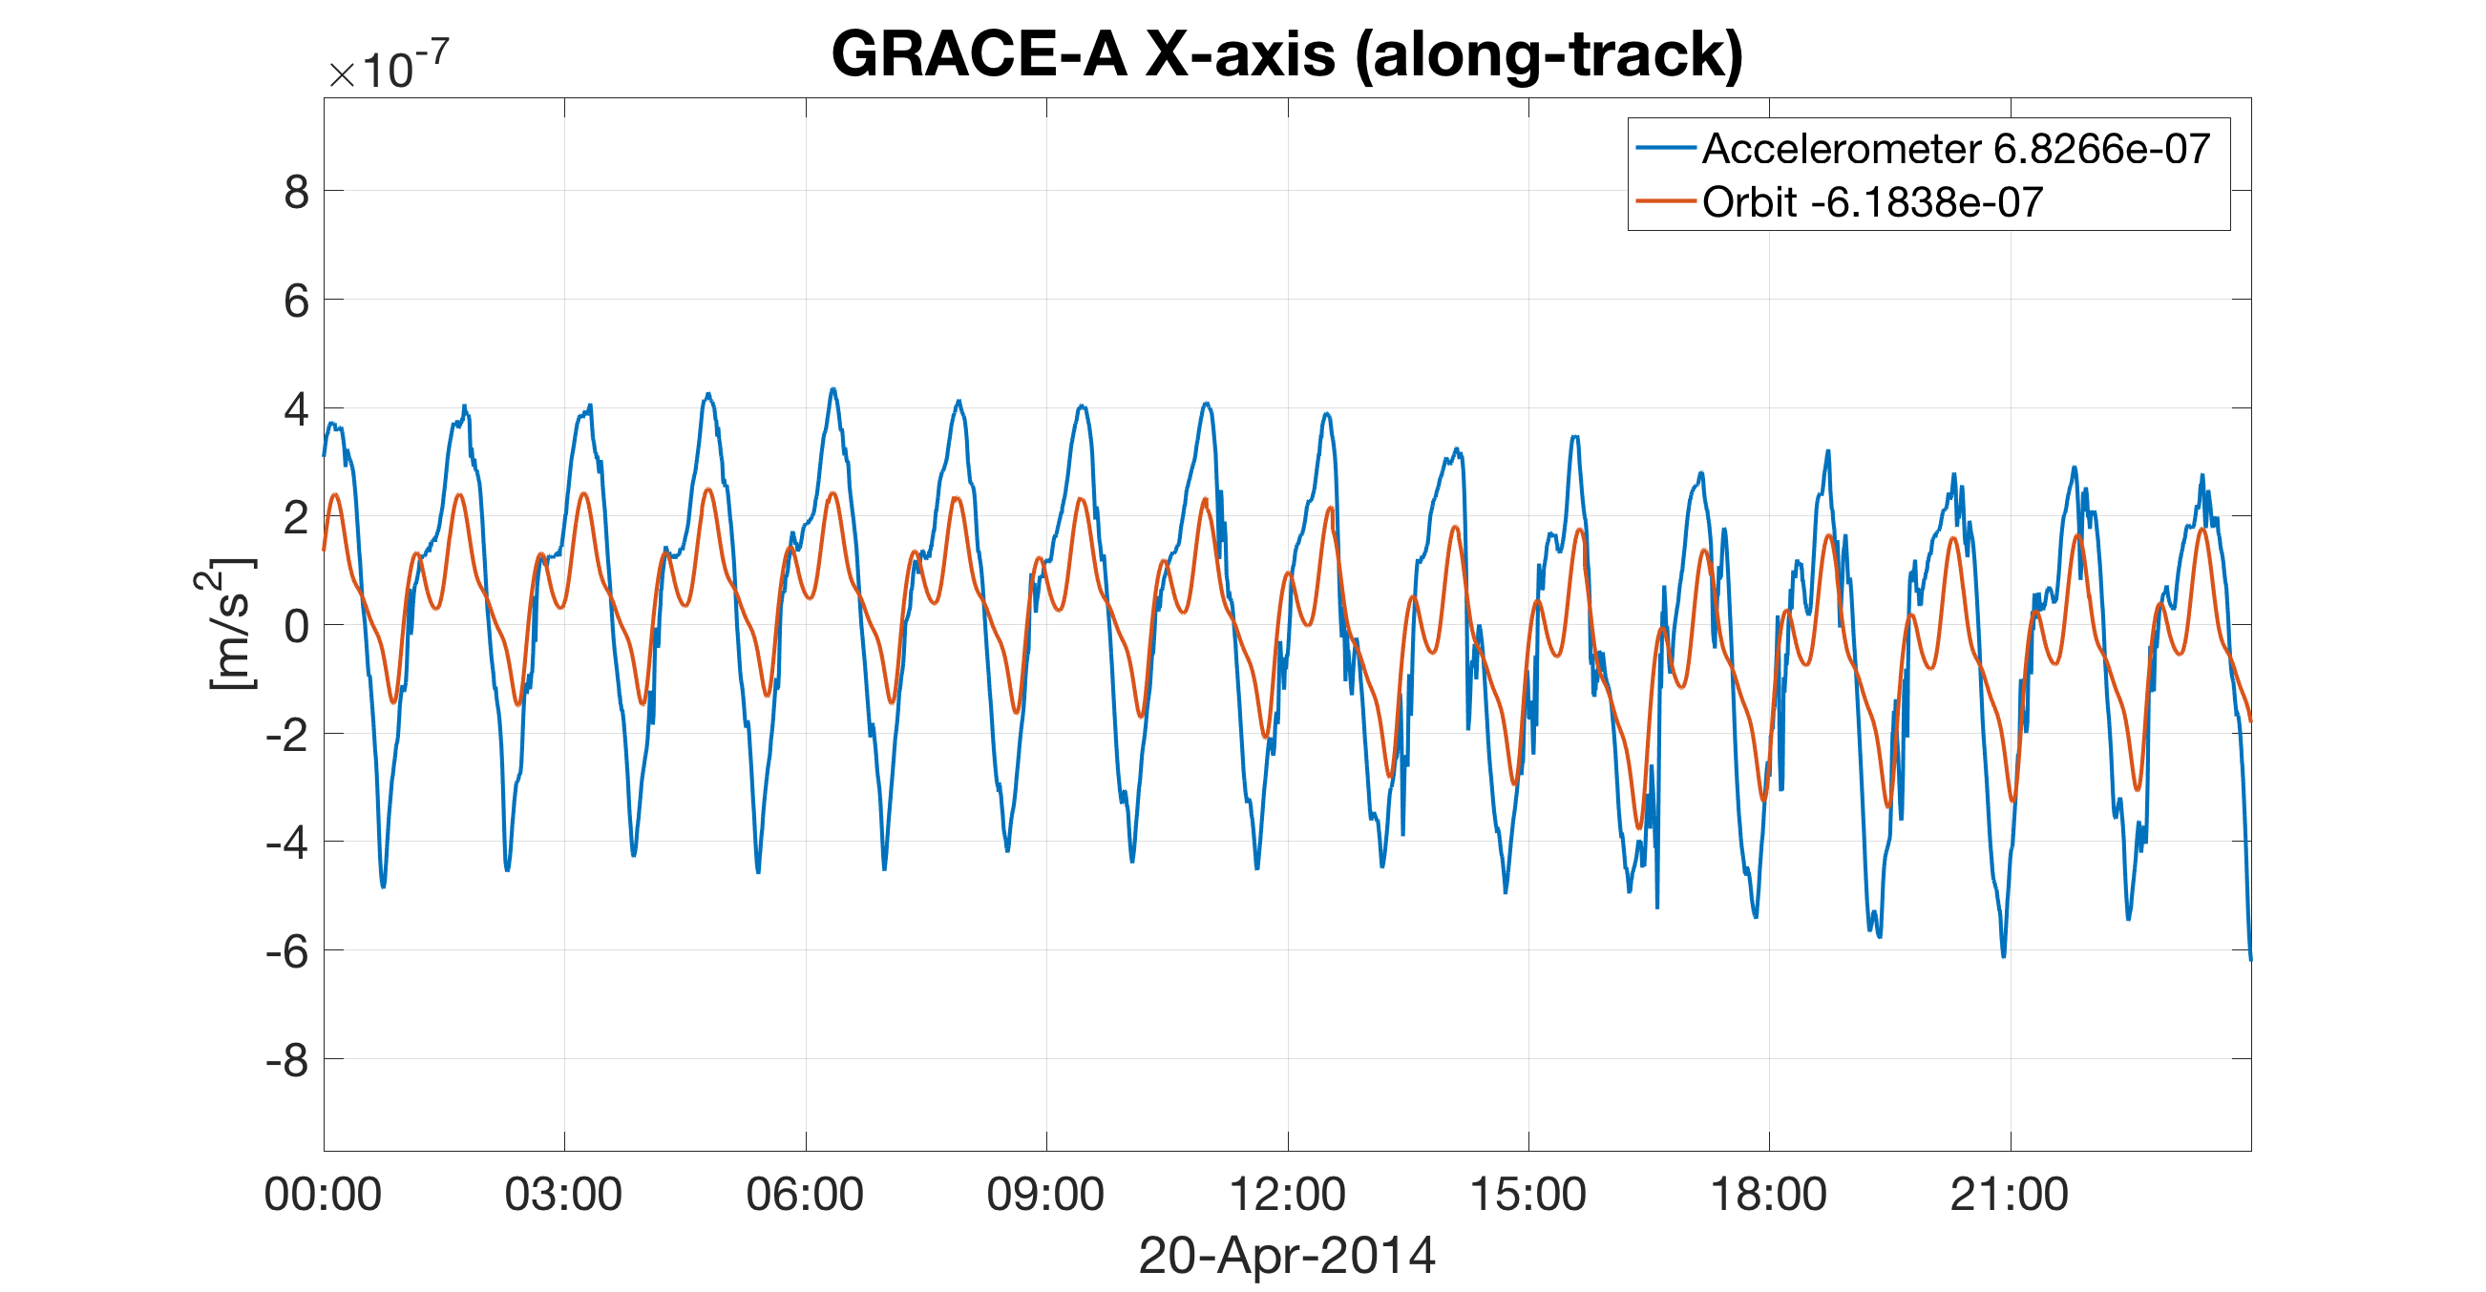
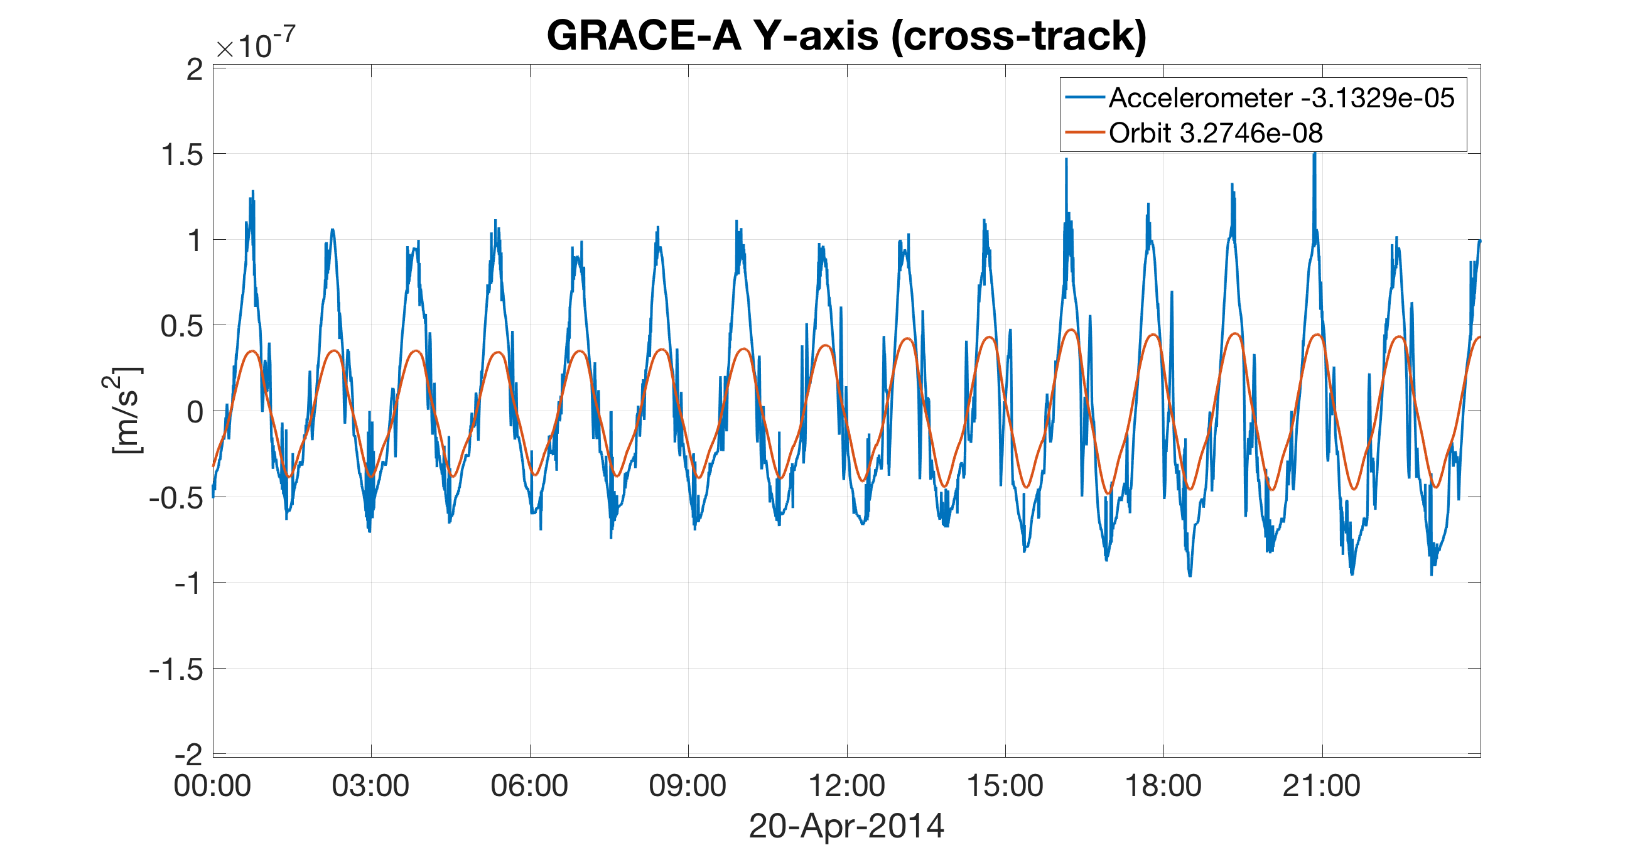
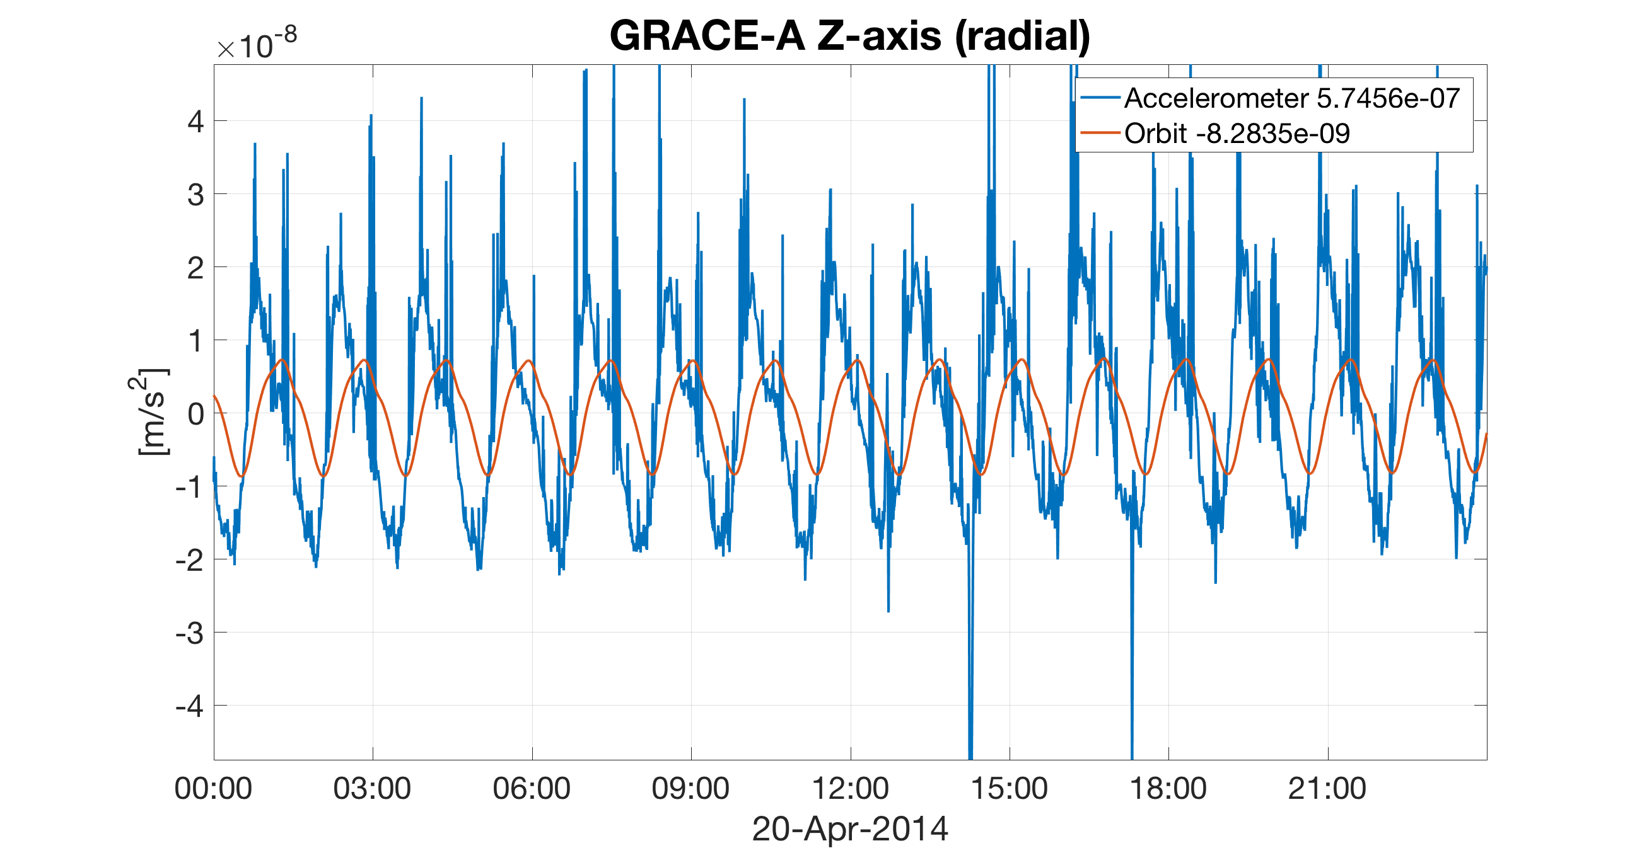
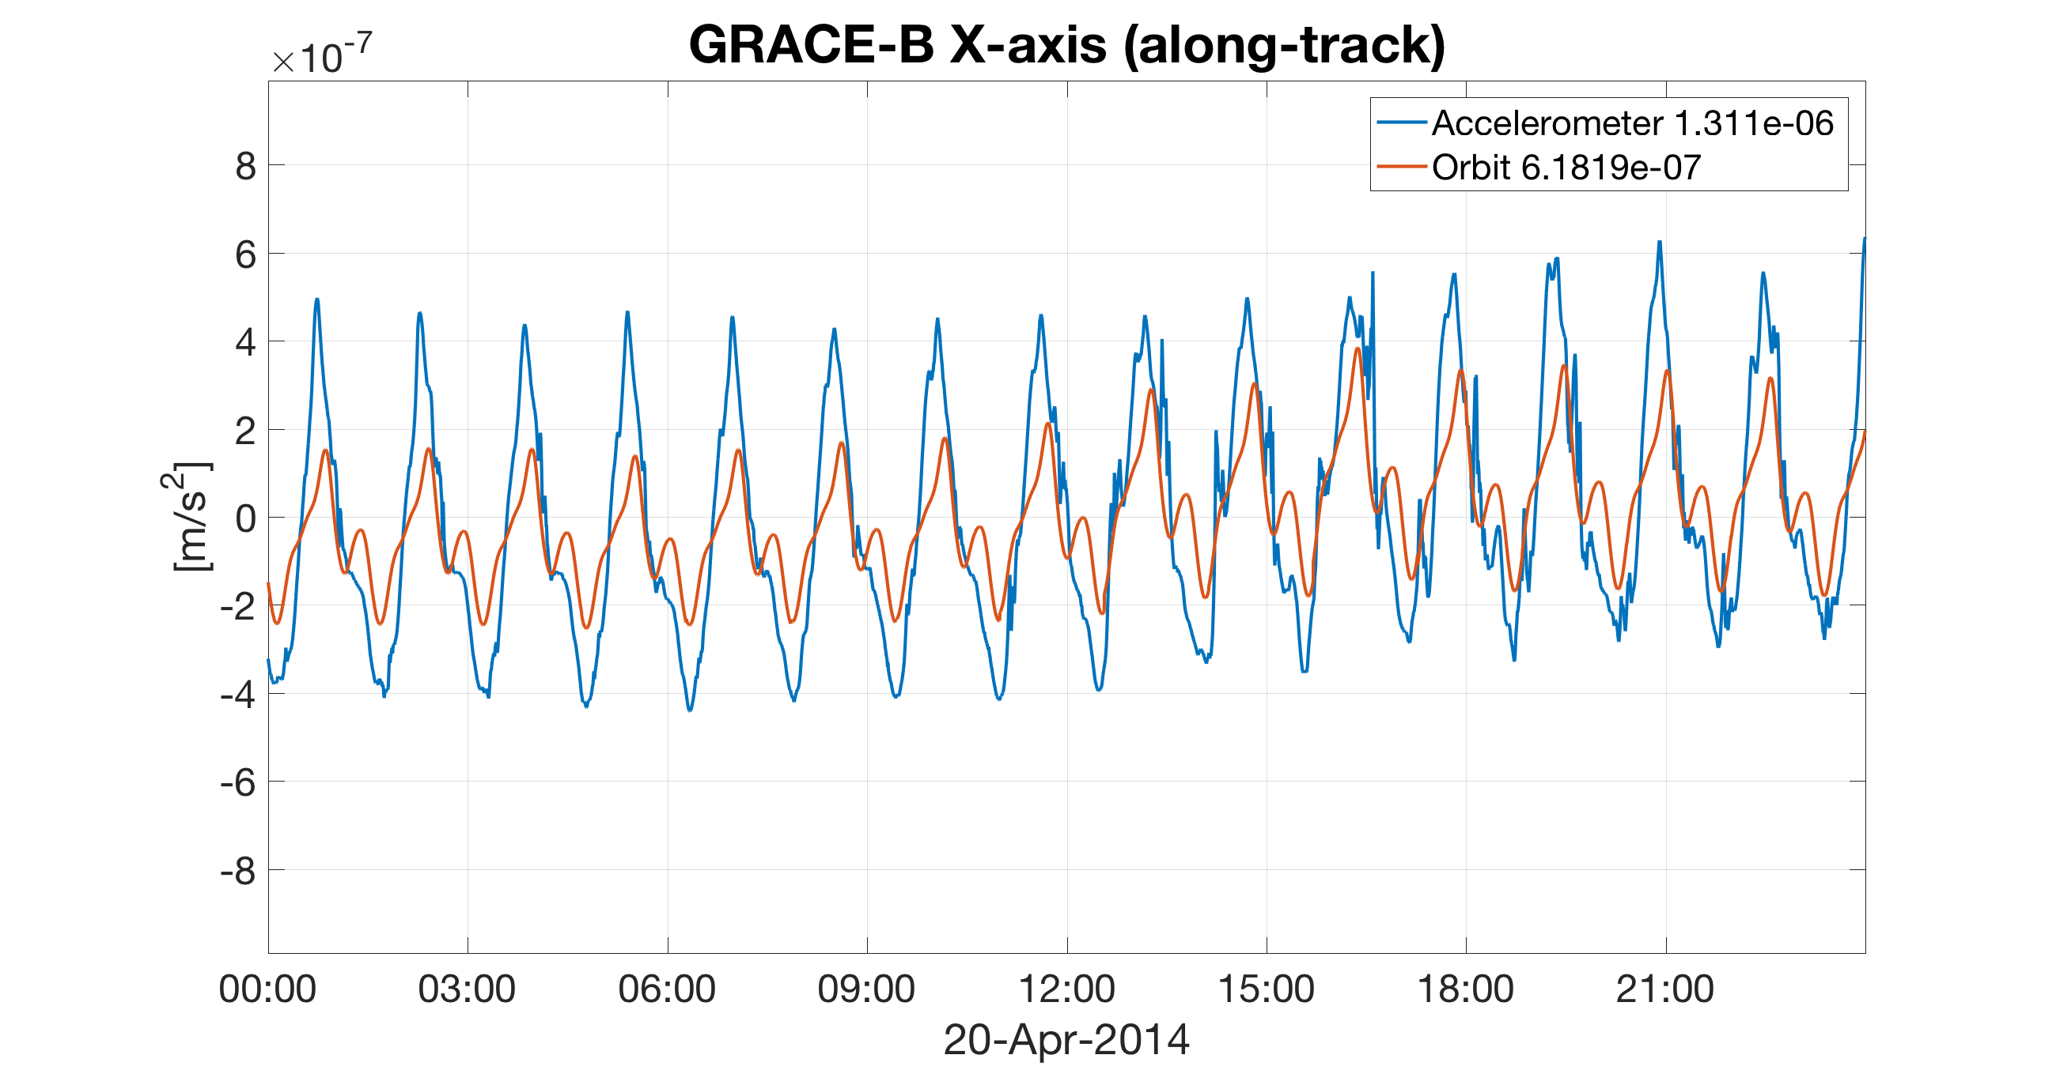
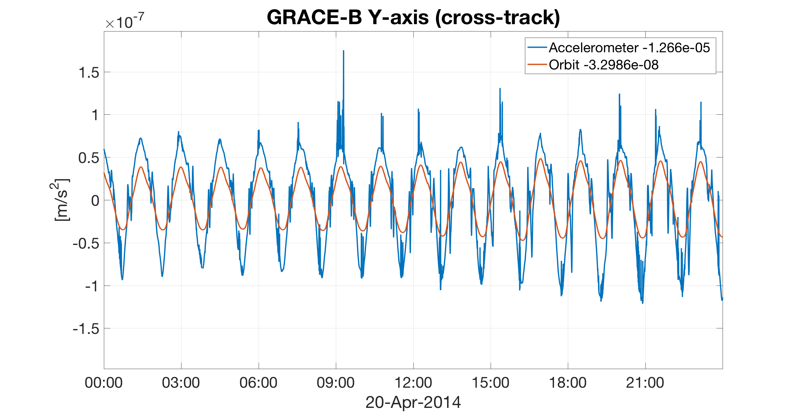
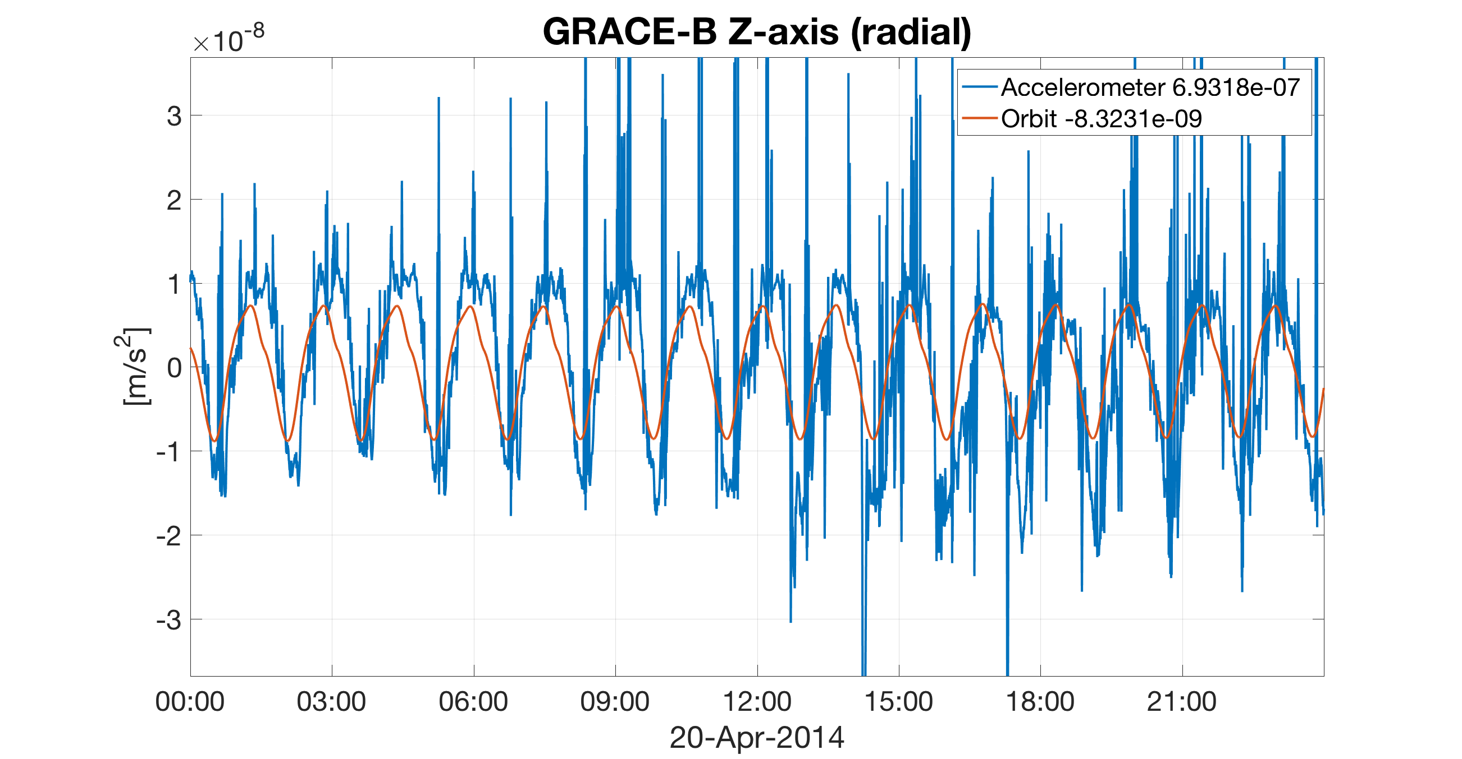
Accelerometer data

Slide 26
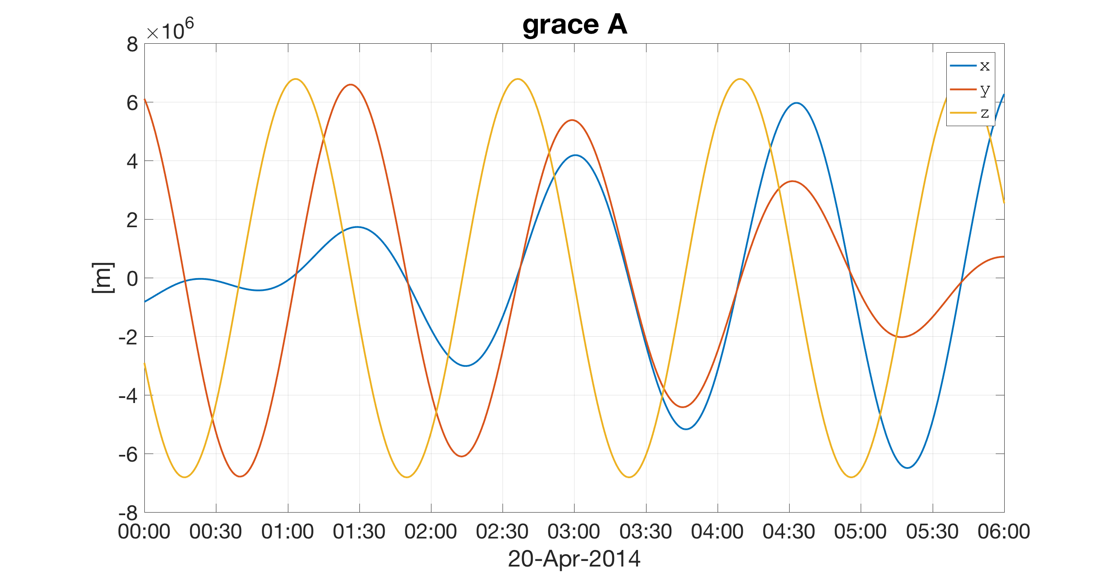
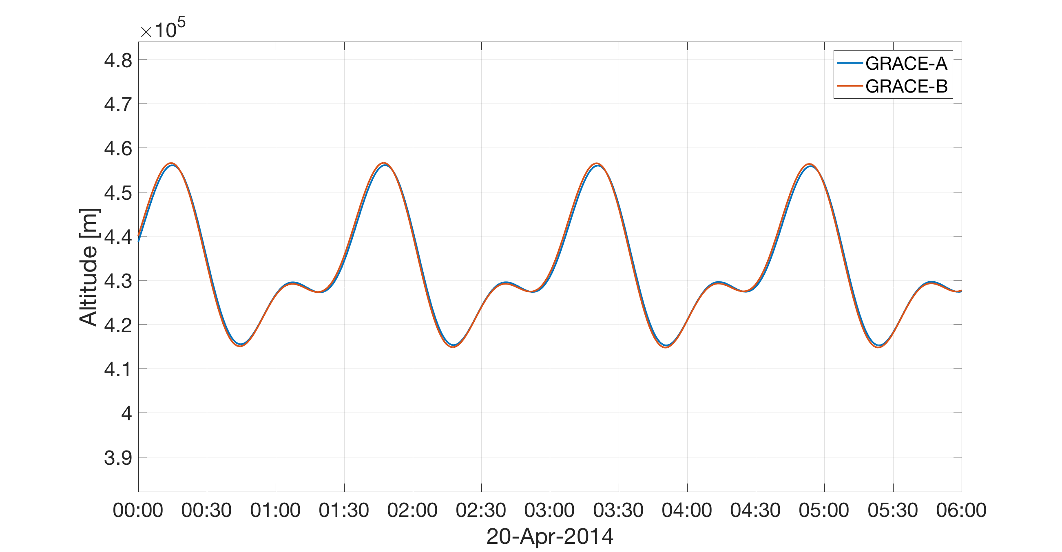
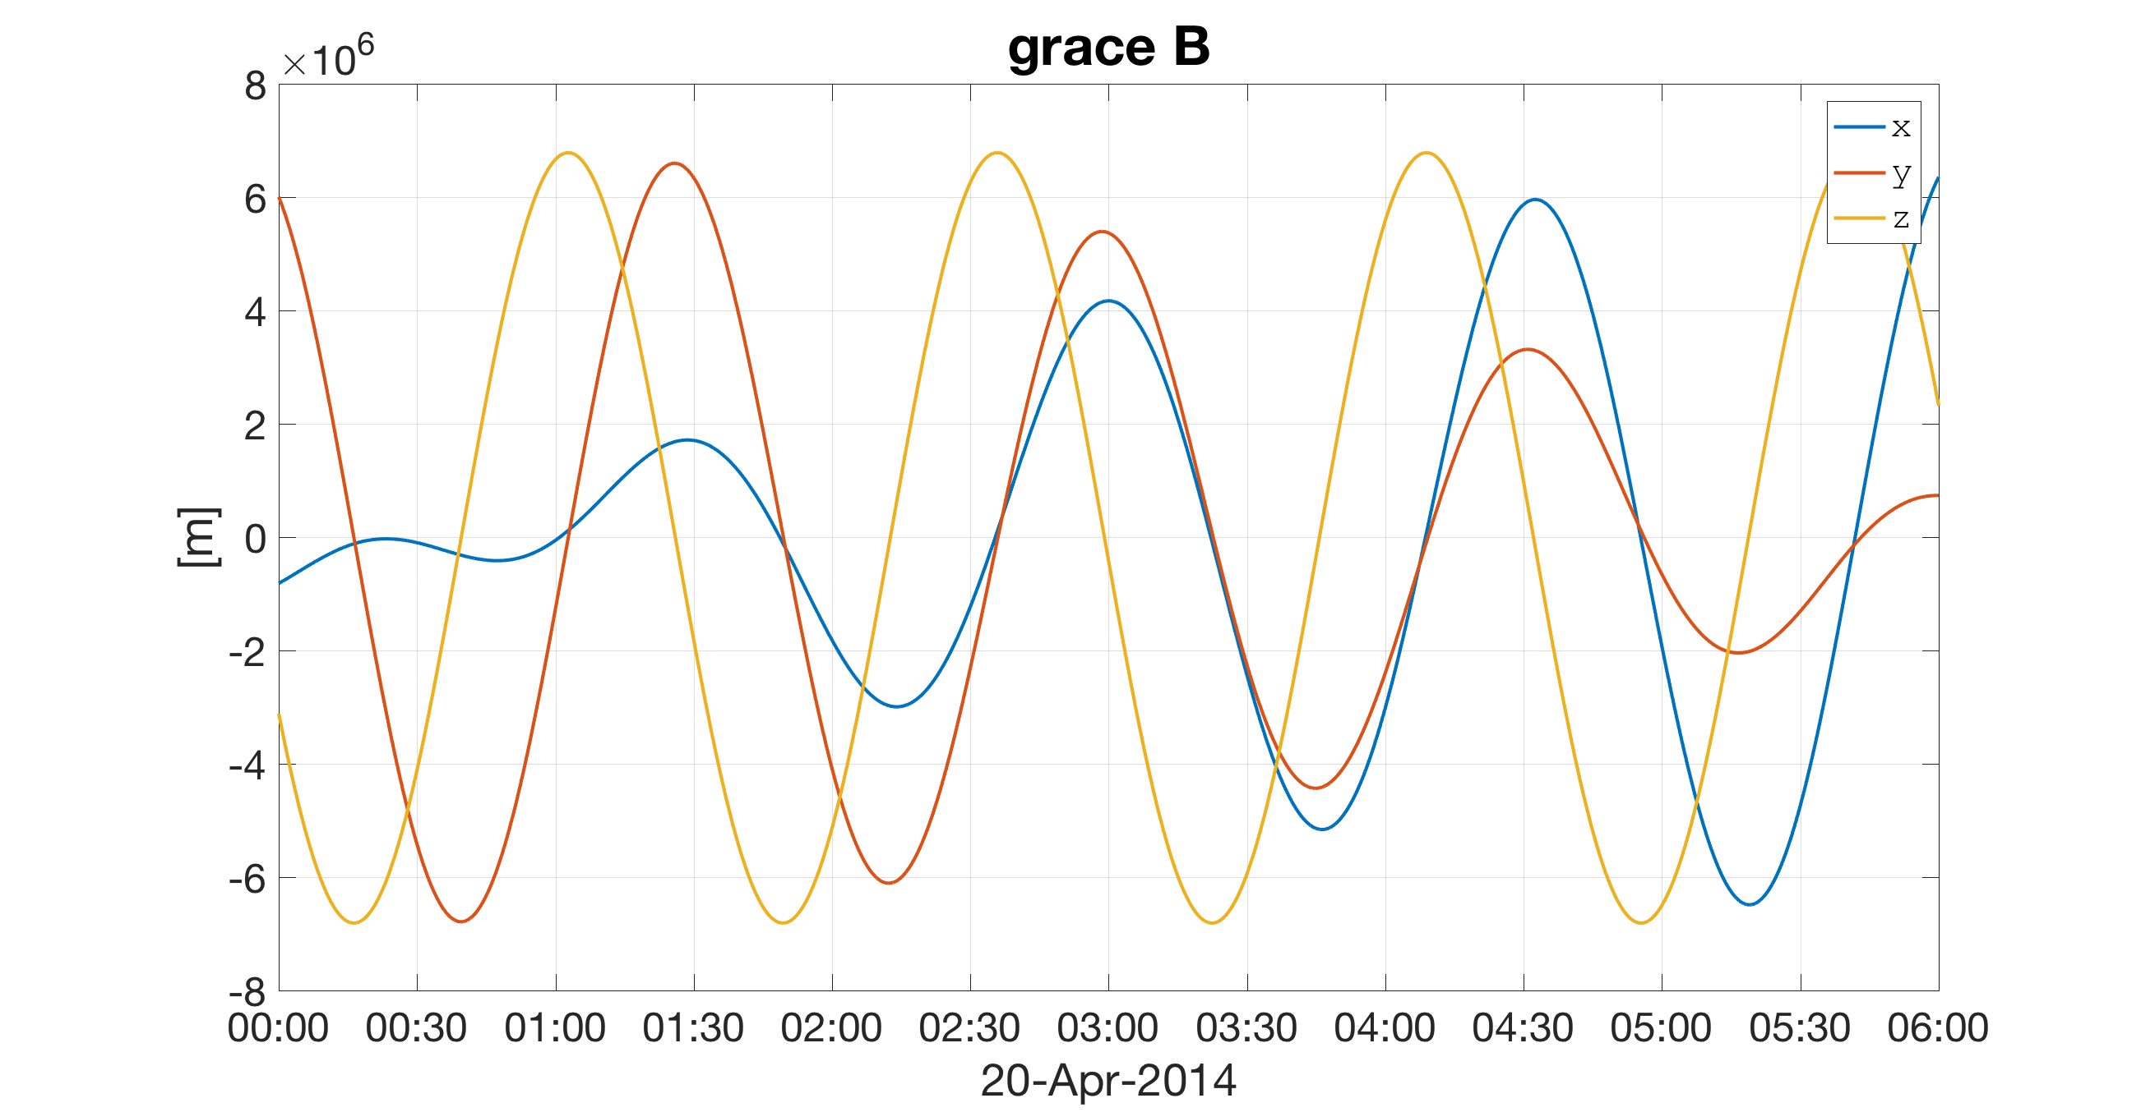
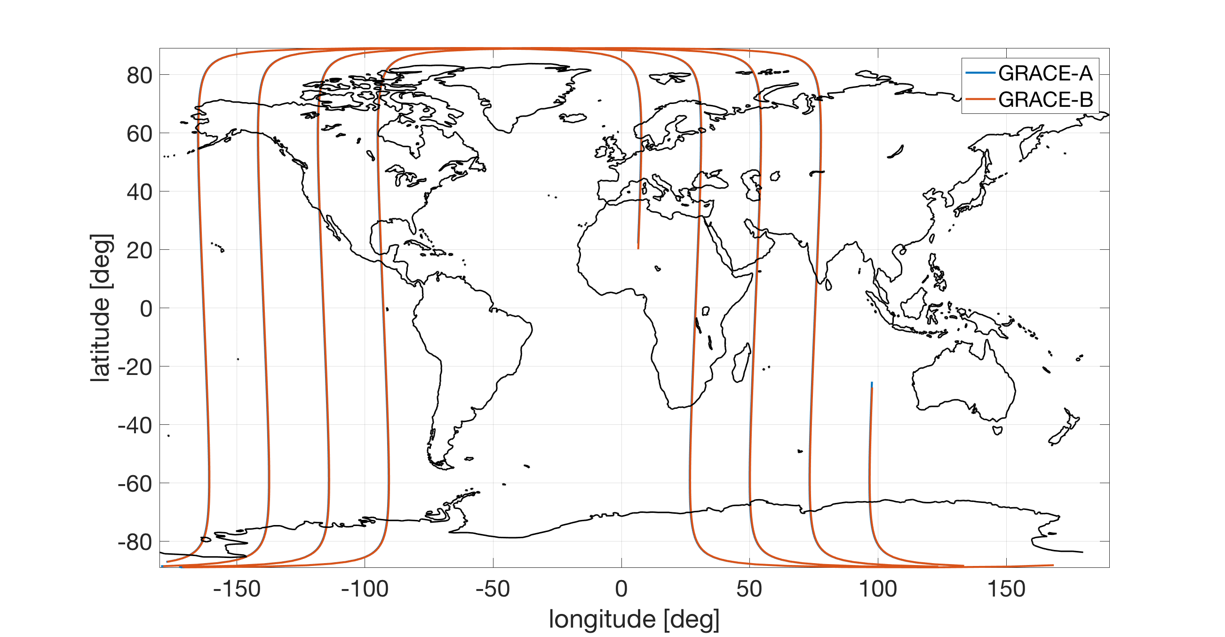
Orbit data

Slide 27
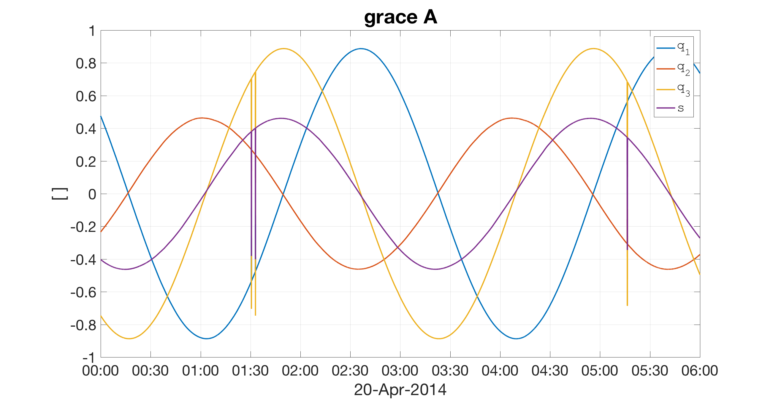
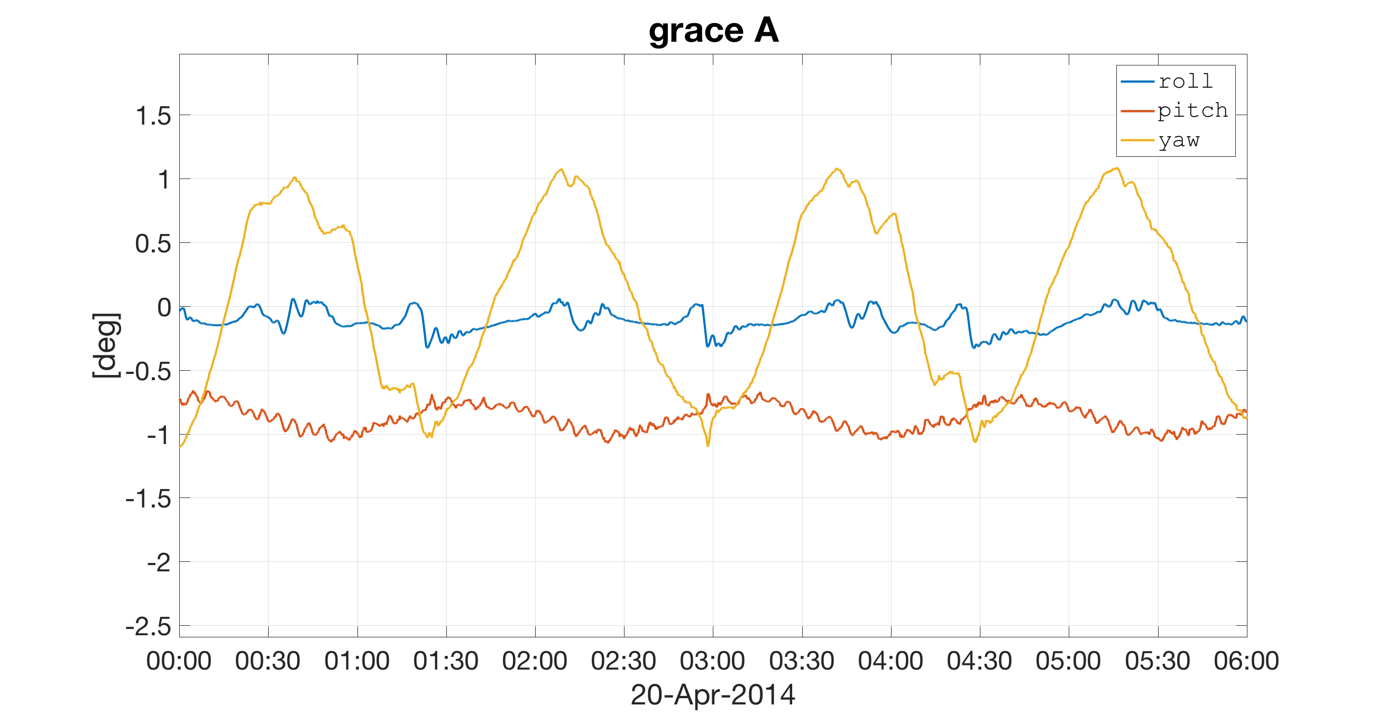
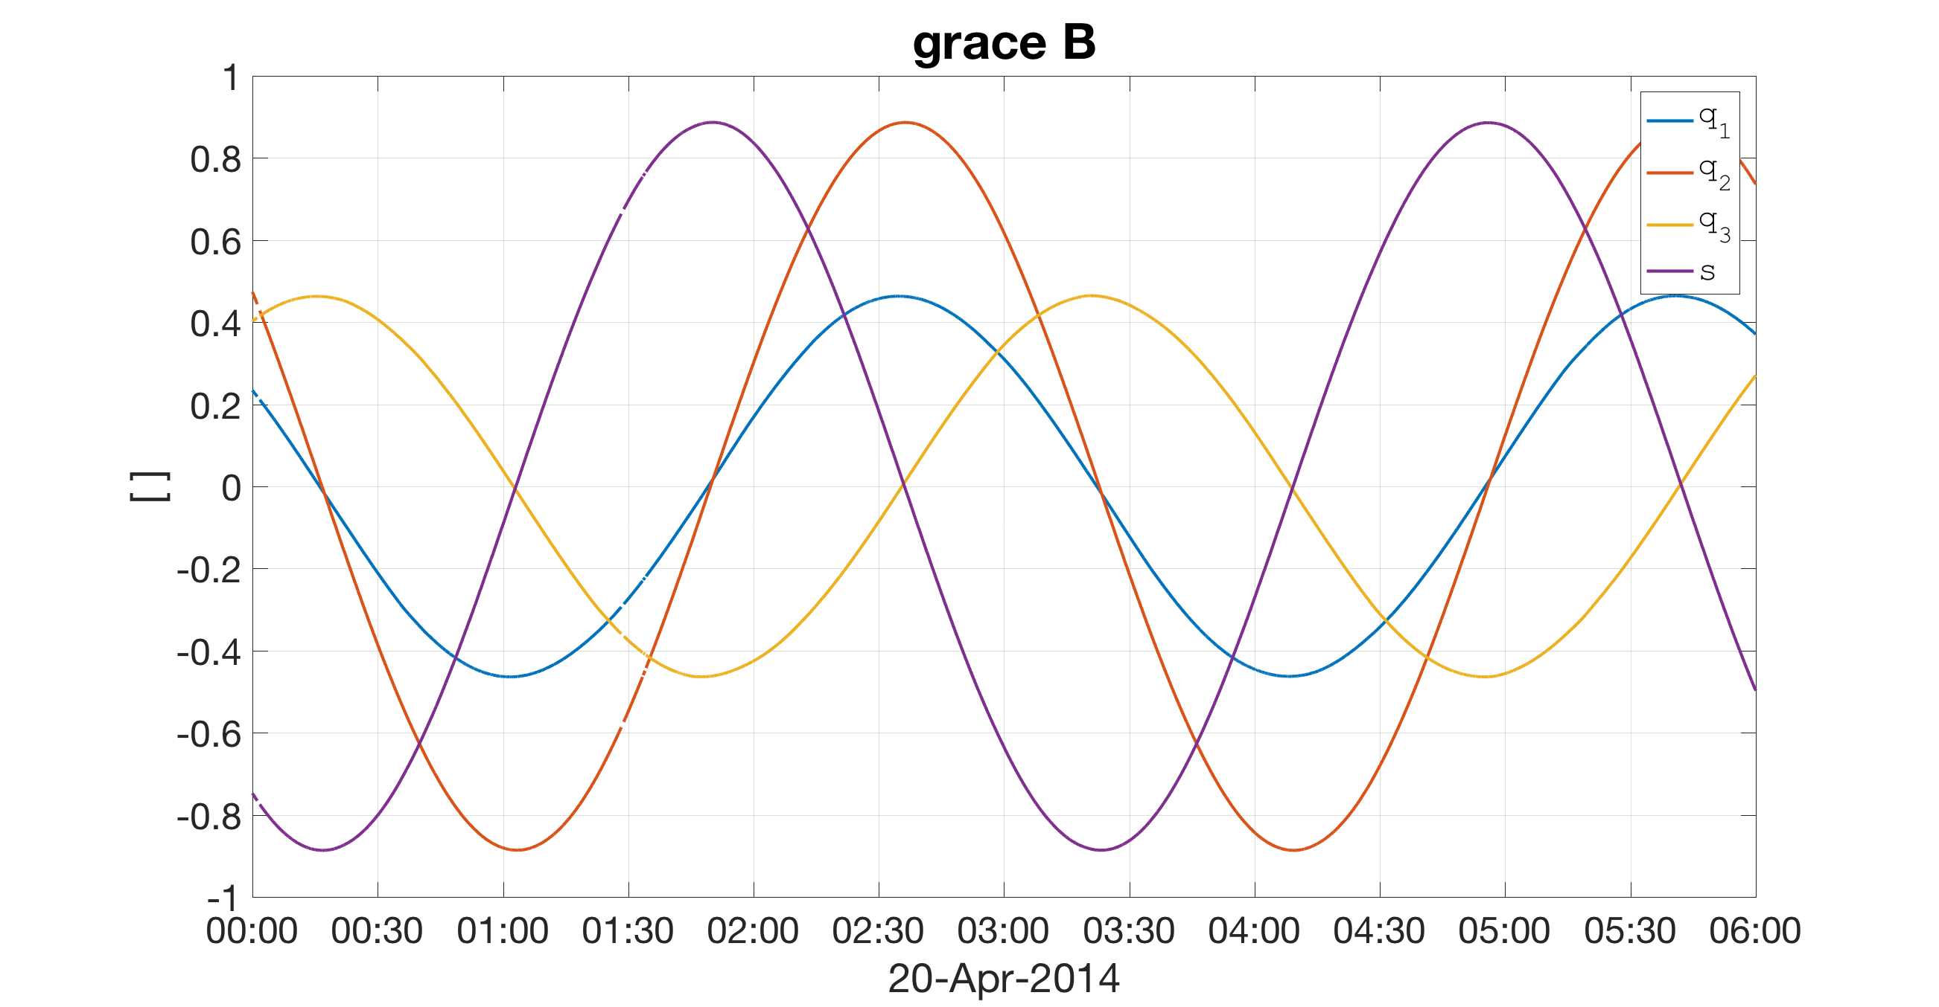
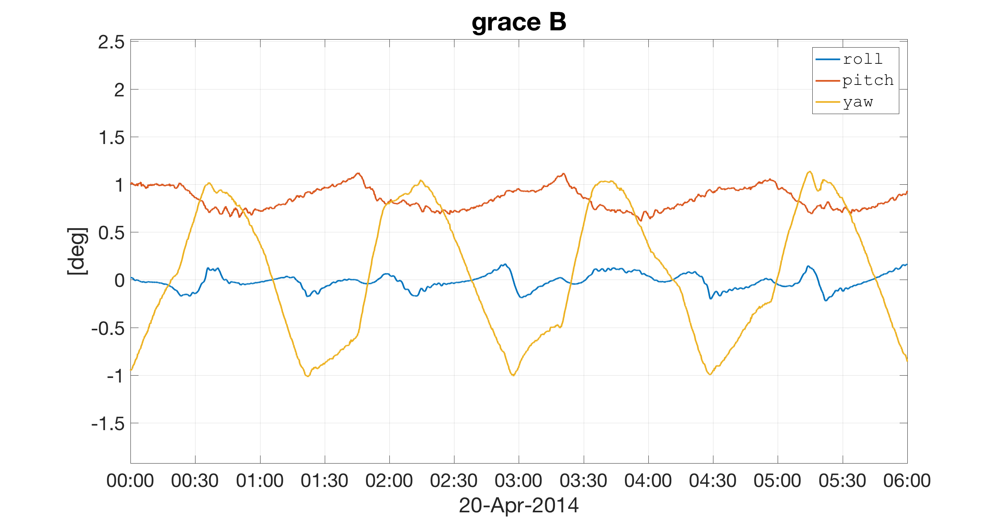
Attitude data

Slide 28
Methodology
How is the data processed?

Slide 29
Newton’s equation

Slide 30
Forces acting on the satellite

Slide 31
Gravitational accelerations

Slide 32
Non-gravitational accelerations

Slide 33
Non-gravitational accelerations
High errors!

Slide 34
Non-gravitational accelerations
The accelerometer measures all that!

Slide 35
Observation equation (epoch-wise)

Slide 36
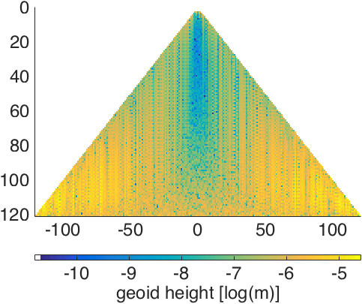
Gravity field parameters: Spherical harmonics

Slide 37
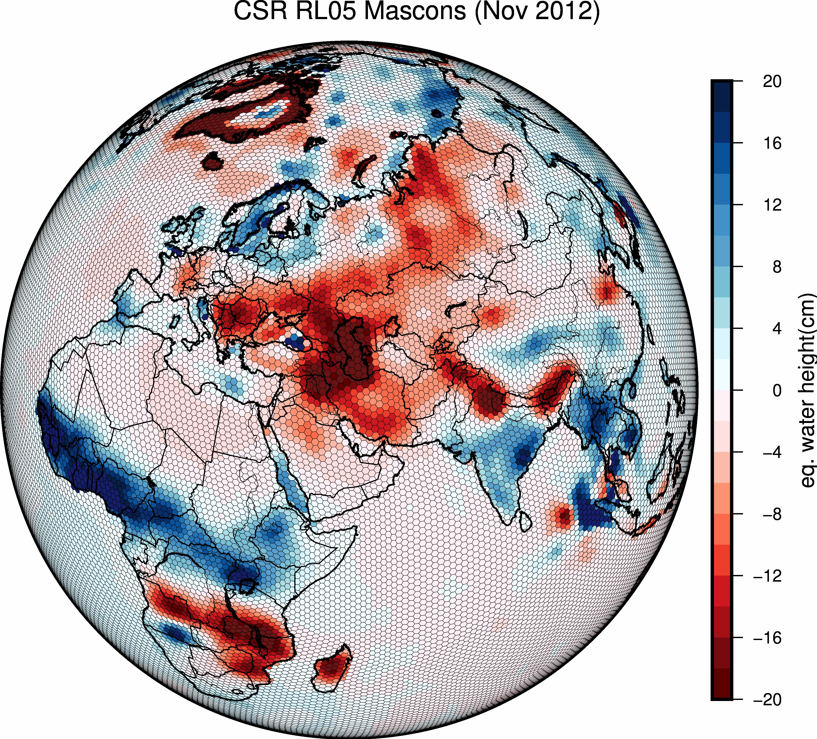
Gravity field parameters: “mascons”

Slide 38
Processing strategies
How are the gravity field parameters estimated?

Slide 39
Processing strategies: In-situ observations
The observations are “reduced”, i.e. they are “cleaned” of:
non-gravitational information (atmospheric drag, solar radiation pressure, Earth albedo)
Trivial gravitational information (tides, astronomical bodies)
Un-observable gravitational information (atmosphere and ocean mass transport)
And:
A solution for the orbit ( ) has to be available a-priori
But:
The orbit depends on the gravity field
So:
Only kinematic orbits can be used

Slide 40
Processing strategies: Variational Equations
The orbit ( ) is co-estimated along with the gravity field parameters ( ):

Slide 41
Summary
Satellite gravimetry:
Is a large adjustment problem
Aims at describing a physical field with infinite degrees of freedom
Numerous signal sources, with different wavelengths and frequencies (tides, astronomical bodies, atmosphere and ocean, hydrology, ice-loss, GIA, megathrust earthquakes, mantle processes,…)
Unmodelled or wrongly-modelled signals act as “errors” in the data
Requires global data to solve for parameters describing a global model

